Slide 1



RADCON
TECHNOLOGIES Pvt Ltd

Slide 2


About Our Company
M/S RADCON Technologies (Pvt) Ltd was established in 2018.
Our objective is to drive indigenous development across critical domains including lifesaving equipment, embedded systems, RF & Microwave, simulators, software solutions, and customized mechanical fabrication.
We proudly serve defense, industrial, and technology sectors by continually expanding our expertise, testing facilities, and supply chain to meet evolving challenges.

Slide 3





Multipurpose Electronic Jammers
Broadband RCIED & UAV jamming
Remote-controlled, advanced tech
Customizable through software
RF Amplifiers (1W–1KW+)
LNAs, Switches, Filters, Mixers
Waveguides, Phase shifters
Applications: Radar, Radios, Jammers
RF & Microwave Capabilities
OUR SERVICES
Fire Control Radar
Air/Ground Surveillance
Night Vision & Thermal Sights
Power Supply & Medical Equipment
SDRs & Communication Equipment
Embedded Systems Expertise
Mechanical Fabrication
CNC (3D & 4D), Lathe, Milling
Drilling, Electroplating
Heat treatment

Slide 4
OUR CLIENTS
PAK ARMY
PAF
STRATIGIC FORCES (Nescom, NDC,KRL,PAEC)
CAF (FC KPK, FC Balochistan)
LEAs (Pjb Police, ICT Police Islamabad)

Slide 5
ACHIEVEMENTS
GHQ / DGP Army
•Sky Guard Radar: Repaired camera module, LCD, processing & memory unit, control unit
• Giraffe Radar: Restored rectify unit, video amplifier, control joystick, frequency generator
• AN/PPQ-36 Radar: Serviced tilt sensor, waveguide HV filter, HV power supply/assembly
• MSTAR Radar: Final stage power amplifier, control & driver boards, slip ring PCB repaired
Army Aviation – Qasim Base (MI-17 Helicopter)
Weather radar & avionics: Repaired multifunction display, screen gauges, altimeter

Slide 6
ACHIEVEMENTS
FC KPK South
•Supplied advanced Electronic Countermeasures:
– A5, HH, Vehicular & Drone Jammers
– Direction Finders (VHF Band)
Fabrication & Mechanical Parts Support: Successfully delivered high-precision parts to:
• KRL, NDC, NESPAK, NESCOM, HI
• 1 KW Final Stage Power Amplifier for YLC-6 Radar of PAF

Slide 7

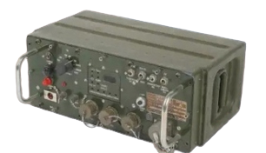
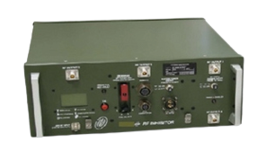
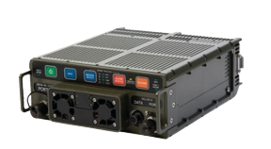
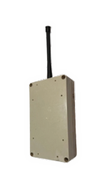
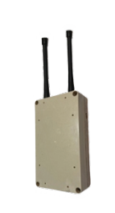
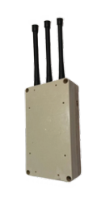
RFIED JAMMERS

Slide 8

VEH MOUNTED JAMMERS
VJAM 300
Cover VHF, UHF and ISM bands sweep jamming
10 Programmable Spots against known threats
Net output power is 350 Watts
Number of Antennas is 4
Operating Power 24 VDC, 30A
Extra Protection Radius.

Slide 9
VEH MOUNTED JAMMERS
VJAM 600
VHF, UHF, ISM, GSM, 3G and 4G bands sweep jamming
10 Programmable Spots against known threats
Net output power is 650 Watts
Number of Antennas - 7
Operating Power 24 VDC, 55A
Extra Protection Radius

Slide 10
VEH MOUNTED JAMMERS
VJAM 800
20 Mhz-6 GHZ (VHF, UHF, ISM, GSM/LTE, UAV) sweep jamming
15 Programmable Spots against known threats
Net output power is 1000 Watts
Number of Antennas - 10
Operating Power 24 VDC, 80A
Extra Protection Radius

Slide 11
VEH MOUNTED JAMMERS
STOS Jammer
Programmable 410-525MHz band Spot and Sweep jamming
1 Programmable Spots against known threats
Net output power is 50-100Watts
Number of Antennas - 1
Operating Power 12/22 VDC, 5A
Extra Protection Radius

Slide 12
HH STOS JAMMERS
STOS1-JAMMER
STOS BAND
Jamming Radius (50 to 60 Meters)
Battery Backup: 3 hours. Can be extended, subject to weight
Number of Antennas: 1
Input Voltage: 12 VDC
Weight: 0.8kg
Dimension: 160 x 90 x 60mm

Slide 13
HH JAMMERS
NG1-JAMMER
2x Programmable Spots falling between 130 and 170 MHz
2x Programmable Spots falling between 300 and 450 MHz
Jamming Radius (70 to 100 Meters)
Battery Backup: 3 hours. Can be extended, subject to weight
Number of Antennas: 2
Input Voltage: 12 VDC
Weight: 1kg
Dimension: 160 x 90 x 60mm

Slide 14
HH JAMMERS
NG2-JAMMER
Freq coverage 2.4 GHz
Jamming Radius (70 to 100 Meters)
Battery Backup: 3 hours. Can be extended, subject to weight
Number of Antennas: 1
Input Voltage: 12 VDC
Weight: 1kg
Dimension: 160 x 90 x 60mm

Slide 15
HH JAMMERS
NG3-JAMMER
2x Programmable Spots falling between 130 and 170 MHz
2x Programmable Spots falling between 300 and 450 MHz
2.4 GHz
Jamming Radius (70 to 100 Meters)
Battery Backup: 2 hours. Can be extended, subject to weight
Number of Antennas: 3
Input Voltage: 12 VDC
Weight: 1.7 kg
Dimension: 160 x 90 x 60mm

Slide 16
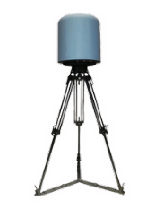
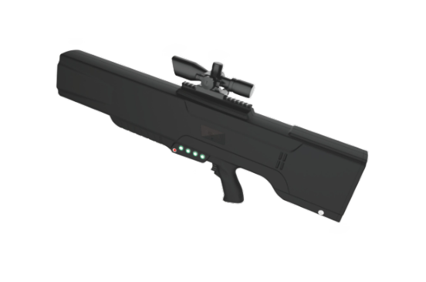
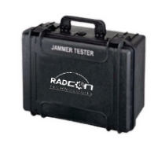
UAV JAMMERS

Slide 17
UAV JAMMERS
RJ ADS
Frequency Range 400 MHz to 6 GHz
Detection Range 5 to 10 KM
Jamming Range UPTO 8 KM
Maximum Tracking Number 8 to 10
Coverage angle 360°
Input 24VDC

Slide 18
UAV JAMMERS
GUN JAMMER
Effective Jamming Distance > 1500m
Frequency Band :
Channel 1 (GNSS)
Channel 2 (GPS)
Channel 3 (2.4GHz)
Channel 4 (5.8GHz)
Number of antenna: 4
Input : 24 VDC
Weight: 3 KG

Slide 19
JAMMER TESTING DEVICE
Programable
Band 1: 20 to 100 MHz
Band 2: 100 to 300 MHZ
Band 3: 300 to 500 MHZ
Band 4: ISM Band
Further can be customized as required
Battery Timing : 2Hr

Slide 20
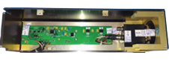
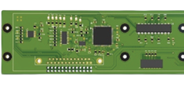
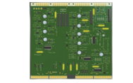
EMBEDDED SYSTEMS

Slide 21
EMBEDDED SYS
FIRE CONTROL TRACKING RADAR SYSTEM
Camera Module
LCD TV Monitor
Memory Unit
Power Supply 5 Amp
Rectifier Unit 26KV
Power Supply 7 Amp
Jamming Control Card PCBA
Speed Control PCBA

Slide 22
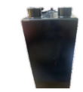
EMBEDDED SYS
FIRE CONTROL RADAR SYSTEM
High voltage power supply
Frequency meter
Tracking joystick Module
Rectifier unit 30 KV Surveillance
Frequency change PCBA
Control card PCBA
Video amplifier PCBA

Slide 23
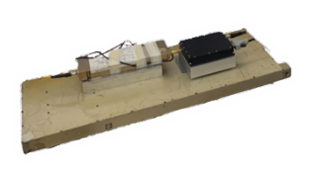
EMBEDDED SYS
SURVELLIANCE RADAR
Final stage power amplifier 1KW of YLC-6
Phase shifter (Including TPS - 77 RADAR)
Power amplifier YLC 2

Slide 24
EMBEDDED SYS
OPTRONICS
Sophie sight (NOAD and FOAD Kit)
Peg belt Sophie sight
Rotating Unit for TWS
Day Camera and its interface PCBA

Slide 25
THANK YOU

